Slide 1
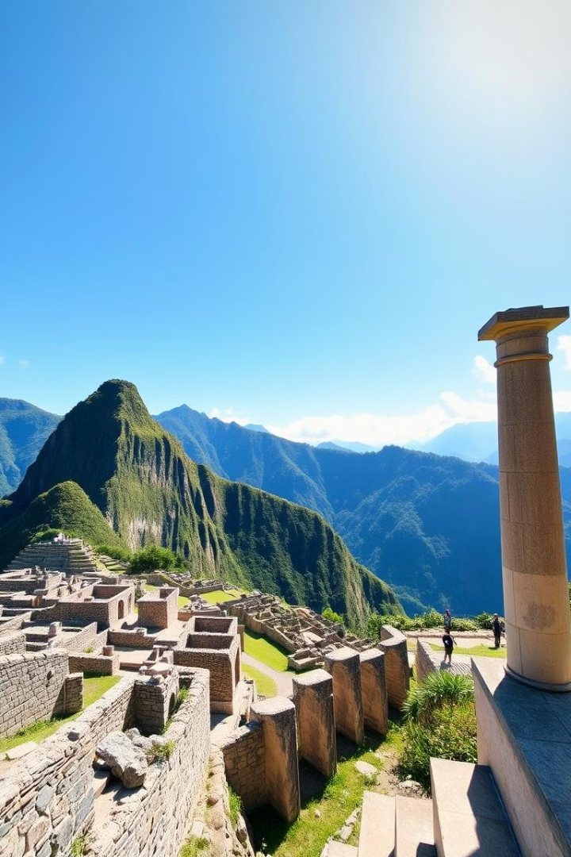

The Inca Civilization: Legacy of Innovation
Welcome to our exploration of the Inca Civilization, a remarkable empire that thrived in the Andes Mountains of South America from the 13th to 16th centuries. This presentation delves into their impressive advancements in science, technology, and society, shedding light on their enduring legacy.
by Lance Miraran

Slide 2
A Glimpse into Inca Society
Rise of the Inca
Inca Society
The Inca Empire emerged in the 13th century, expanding rapidly through conquest and diplomacy. They established a vast and complex society, centered around agriculture, trade, and military prowess.
Inca society was divided into a hierarchical structure, with the emperor at the top and commoners at the bottom. The empire thrived on cooperation, community, and a strong belief in their deities.

Slide 3




Engineering Marvels
Inca Roads
The Inca constructed an extensive network of roads that spanned thousands of miles across rugged terrain, facilitating trade, communication, and military movements.
Suspension Bridges
They pioneered the use of suspension bridges, utilizing woven fibers to create resilient bridges across deep gorges and rivers.
Irrigation Systems
The Inca developed intricate irrigation systems, channeling water from mountain streams to irrigate their crops, ensuring agricultural productivity in a challenging environment.

Slide 4

Inca Cultural Achievements
1
Quipu
2
Textiles & Clothing
3
Inca Art
A unique record-keeping system, employing knotted ropes to represent numerical and symbolic information, allowing for data storage and communication.
The Inca excelled in weaving, producing textiles of exceptional quality, using colorful dyes, intricate patterns, and innovative techniques.
Their art reflected their intricate worldview, from finely crafted pottery and metalwork to elaborate stone carvings and murals.

Slide 5

Scientific Insights of the Inca
1
Calendar System
The Inca calendar, based on the lunar cycles, consisted of 12 months and was used to track agricultural seasons and ceremonial events.
2
Agricultural Practices
The Inca implemented sustainable agricultural practices, such as terracing, crop rotation, and fertilization, to maximize food production.
3
Medical Knowledge
The Inca possessed extensive knowledge of herbal remedies and healing techniques, employing plants and minerals to treat ailments.

Slide 6
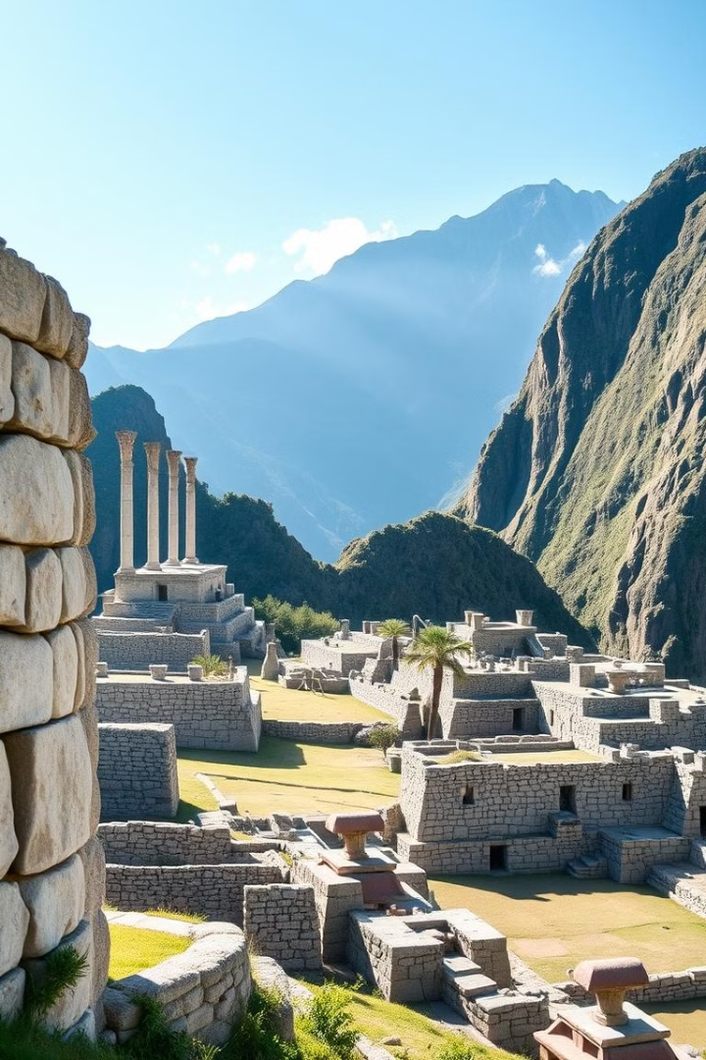
A Legacy That Echoes
Engineering Prowess
Cultural Impact
The Inca's road network, irrigation systems, and bridges continue to inspire engineers today, serving as testaments to their remarkable skills.
The Inca's textiles, art, and traditions continue to influence art and design in South America, preserving their artistic heritage.
Enduring Influence
Their sophisticated social structures, agricultural innovations, and scientific understanding provide valuable insights into ancient civilizations.

Slide 7




The Enduring Legacy
Resilience
Innovation
Cultural Richness
The Inca civilization faced challenges, adapting to their environment and overcoming obstacles. They demonstrated resilience and adaptability.
Their innovative solutions to various challenges, from engineering to agriculture, represent a testament to their ingenuity and creativity.
The Inca legacy lives on through their cultural traditions, artistic expressions, and the enduring spirit of their people.

Slide 8

Exploring Further
We invite you to continue exploring the fascinating world of the Inca Civilization, delving deeper into their history, culture, and contributions to science, technology, and society. Their legacy serves as a testament to the power of innovation and human ingenuity, inspiring us to learn from their achievements.

